Slide 1



Experiential Learning
SDG-13 CLIMATE ACTION
Arya Hariharan
1RV22CS029
Shreyashwini R
1RV22CS192
Prabu Jayant
1RV22CY044
Elvis Vincent
1RV22CY065
Aditi Singh
1RV22IS003
Notes:
Elvis

Slide 2

Mentors
Dr. Vinod A R | Associate Professor, Dept. of Civil Engineering
Dr. Jyothi Shetty | Assistant Professor, Dept. of Computer Science and Engineering
Dr. Ashok A R | Associate Professor, Dept. of Computer Science and Engineering
Dr. Eleena Mohapatra | Assistant Professor, Dept. of Electronics and Communication Engineering
Courses
CD252IA | Database Management Systems
IS353IA | Artificial Intelligence and Machine Learning
CS345TA | Theory of Computation
Notes:
Elvis

Slide 3
Key Topic : Carbon Management and Climate Finance
Developing systems for measuring, monitoring, and reducing carbon emissions, while
promoting financial incentives for climate-positive actions like carbon trading and carbon offset projects.
Notes:
Elvis

Slide 4

Project Title : Terra, an AI-based Personalized Carbon Footprint and Offset Companion
A mobile application that allows individuals to measure their carbon footprint and take actionable steps to offset it, creating a connect between individual actions and their global impact
Notes:
Elvis

Slide 5
Background and Motivation
A brief overview of the sustainable development goal, project context and motivation for the idea.
Notes:
Arya

Slide 6
Sustainable Development Goal
13
.1
.2
.3
.a
.b
STRENGTHEN
resilience and adaptive capacity to climate-related hazards and natural disasters in all countries.
Notes:
Shreyashwini

Slide 7

.1
.2
.3
.a
.b
Integrate
Sustainable Development Goal
13
INTEGRATE
climate change measures into national policies, strategies and planning.
Notes:
Shreyashwini

Slide 8
.1
.2
.3
.a
.b
Integrate
Sustainable Development Goal
13
IMPROVE
education, awareness-raising and human and institutional capacity on climate change mitigation, adaptation, impact reduction and early warning.
Notes:
Shreyashwini

Slide 9

.1
.2
.3
.a
.b
Integrate
Sustainable Development Goal
13
IMPLEMENT
the commitment undertaken by developed-country parties to the United Nations Framework Convention on Climate Change to a goal of mobilizing jointly $100 billion annually by 2020.
Notes:
Shreyashwini

Slide 10

.1
.2
.3
.a
.b
Integrate
Sustainable Development Goal
13
PROMOTE
mechanisms for raising capacity for effective climate change-related planning and management in least developed countries
Notes:
Shreyashwini

Slide 11
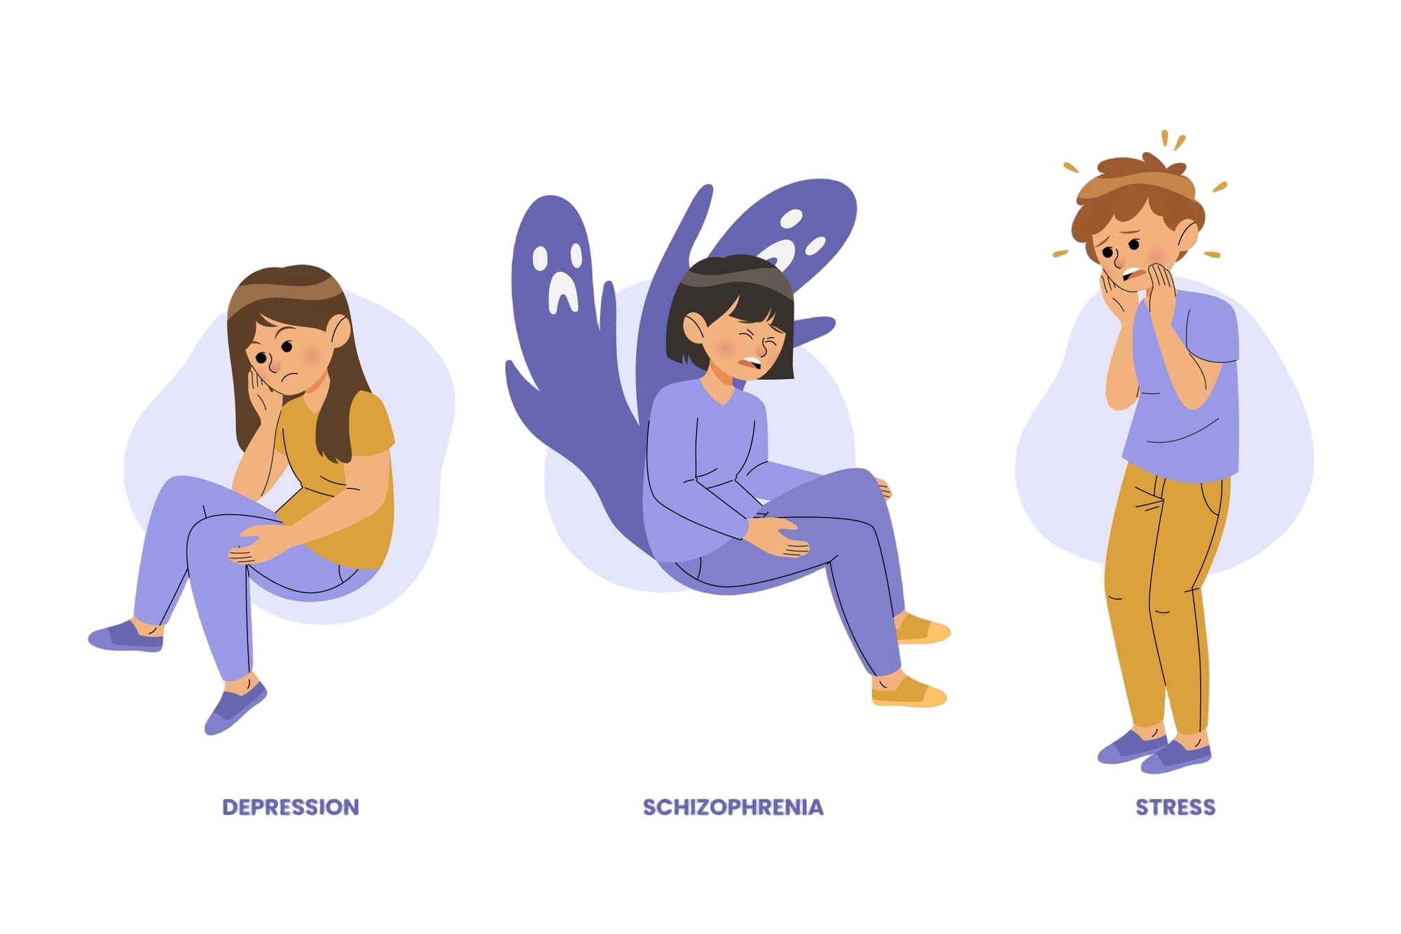



Now, there’s a problem…
A study conducted by Weber concluded that
‘It is psychologically difficult to gain a proper understanding of global phenomena like climate change because of three reasons, one of which is the psychological tendency to rely on personal experience, and to relate our acknowledgement of these phenomena to such personal experiences.’
Notes:
Arya

Slide 12

Now, there’s a problem…
However, more that
of global GHG emissions arise
because of individual actions, with
the largest contributors being transportation, food, waste and consumerism trends.
30%
Notes:
Arya

Slide 13
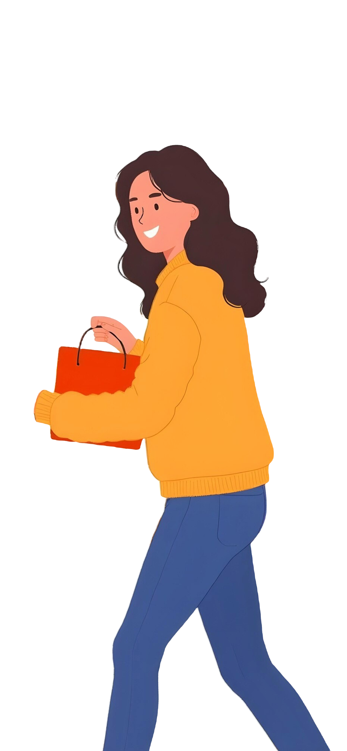
Now, there’s a problem…
In a society with deep individualism and massive consumerism trends, people tend to not see the value of small individual actions for climate change mitigation, as they are viewed in isolation, and not as part of a complete system.
Notes:
Arya

Slide 14


Now, there’s a problem…
2024 was the warmest year ever recorded in history.
India has had the largest increase in GHG emissions (+6.1%) in 2024.
Widespread famine, disease and displacement are eminent consequences.
Notes:
Arya

Slide 15
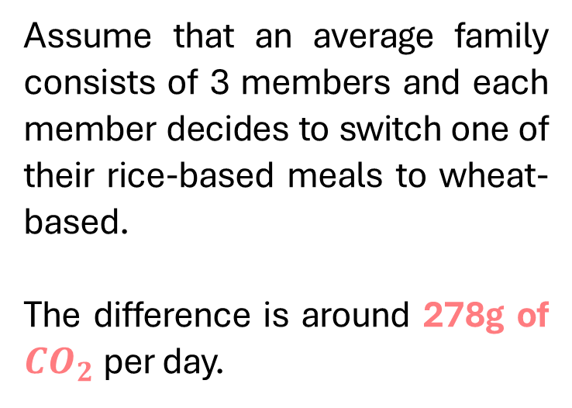
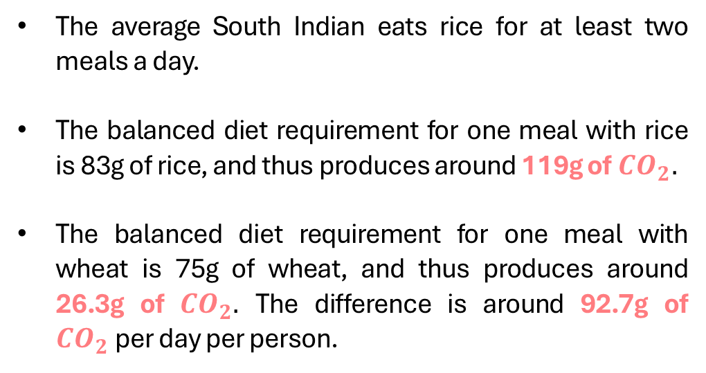
Can our actions help?
To provide a few figures…
The average South Indian eats rice for at least two meals a day.
The balanced diet requirement for one meal with rice is 83g of rice, and thus produces around 119g of ${CO}_{2}.$
The balanced diet requirement for one meal with wheat is 75g of wheat, and thus produces around 26.3g of ${CO}_{2}.$ The difference is around 92.7g of ${CO}_{2}$per day per person.
Assume that an average family consists of 3 members and each member decides to switch one of their rice-based meals to wheat-based.
The difference is around 278g of ${CO}_{2}$per day.
Notes:
Arya

Slide 16
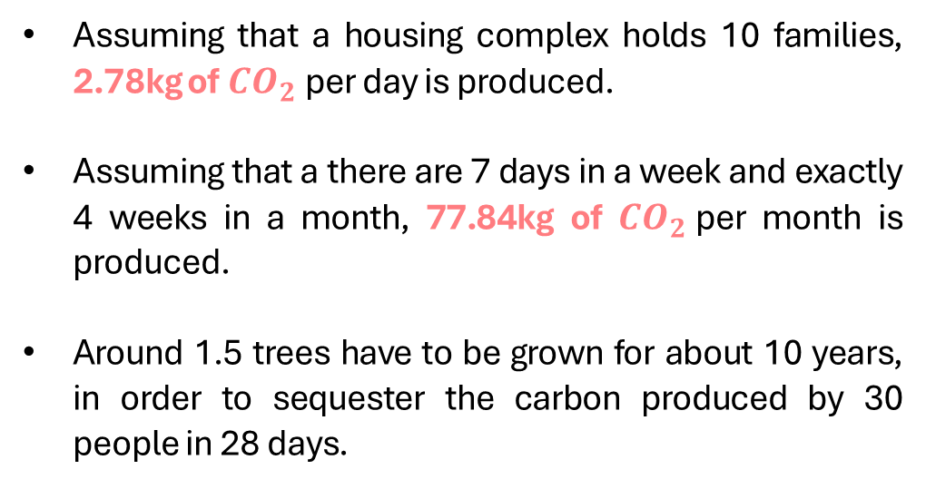
Can our actions help?
To provide a few figures…
The city of Bengaluru has a population of 13.6 million people as of 2023.
Assuming 50% of people in Bengaluru follow this diet, 2,91,741 trees have to planted and grown for 10 years in order to sequester the carbon produced in 1 month.
Assuming that a housing complex holds 10 families, 2.78kg of ${CO}_{2}$per day is produced.
Assuming that a there are 7 days in a week and exactly 4 weeks in a month, 77.84kg of ${CO}_{2}$per month is produced.
Around 1.5 trees have to be grown for about 10 years, in order to sequester the carbon produced by 30 people in 28 days.
Notes:
Arya

Slide 17
Can our actions help?
To provide a few figures…
The city of Bengaluru has a population of 13.6 million people as of 2023.
Assuming 50% of people in Bengaluru follow this diet, 2,91,741 trees have to planted and grown for 10 years in order to sequester the carbon produced in 1 month.
2,369 homes energy use for one year.
4,115 petrol-powered cars can be driven for one year.
6,235 tons of waste recycled instead of landfilled.
891 garbage trucks of waste recycled instead of landfilled.
17,698 acres of forests are needed to sequester this carbon over one year.
Notes:
Arya

Slide 18
Our Goal
is to mitigate this issue by allowing users to understand how each of their individual actions impact climate change, and how their choices can be translated to create a global impact, and thus allowing them to make smarter and more sustainable choices.
Notes:
Prabu

Slide 19
Literature Survey
A brief overview of the papers and publications referred in the process of framing our objectives and methodology, with a focus on the aim of the research, methodology followed and results and limitations of the work.
Notes:
Prabu

Slide 20
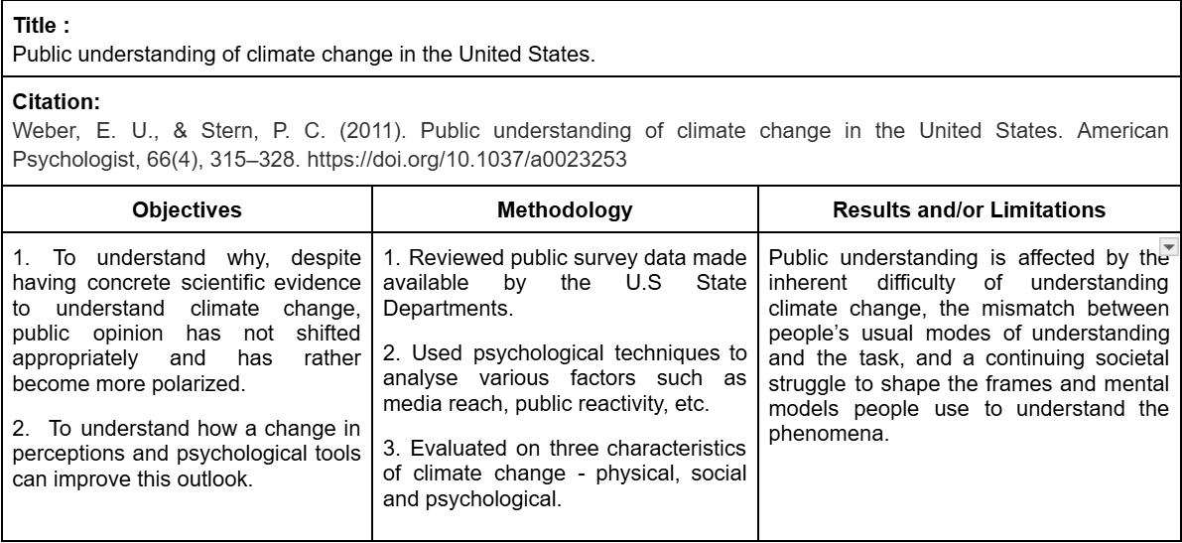
Literature Survey
Notes:
Arya

Slide 21
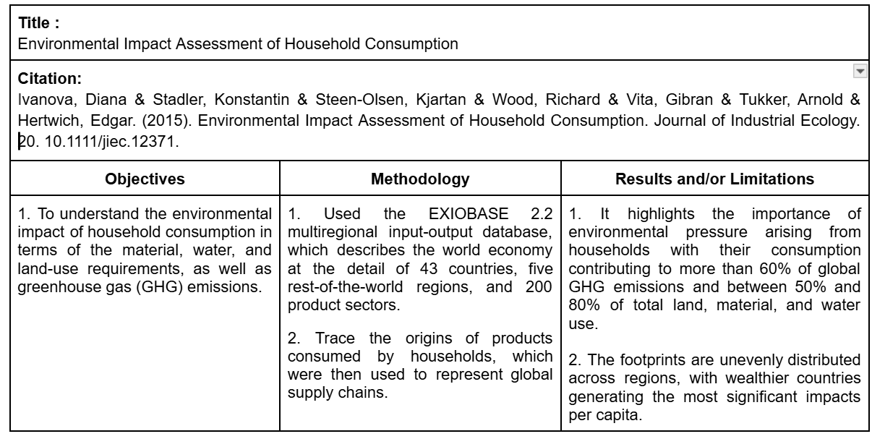
Literature Survey
Notes:
Arya

Slide 22
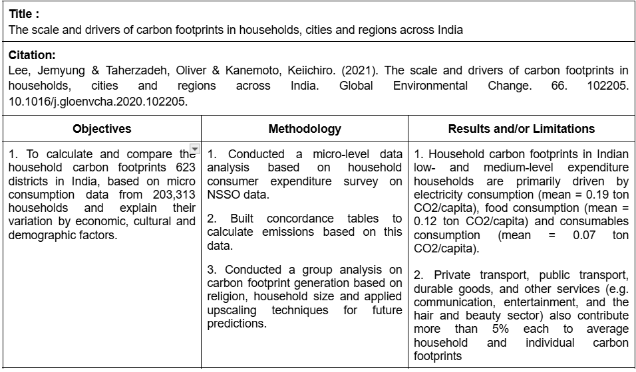
Literature Survey
Notes:
Arya

Slide 23
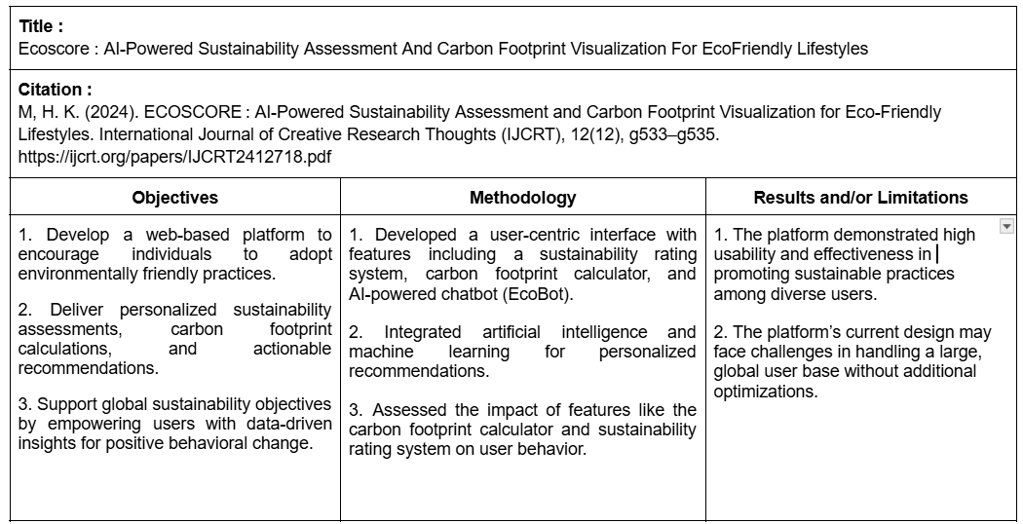
Literature Survey
Notes:
Prabu

Slide 24
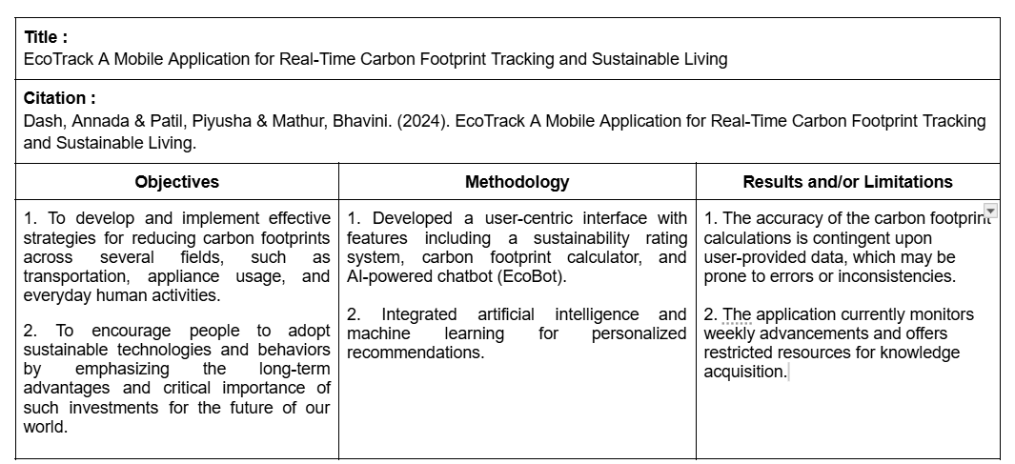
Literature Survey
Notes:
Prabu

Slide 25
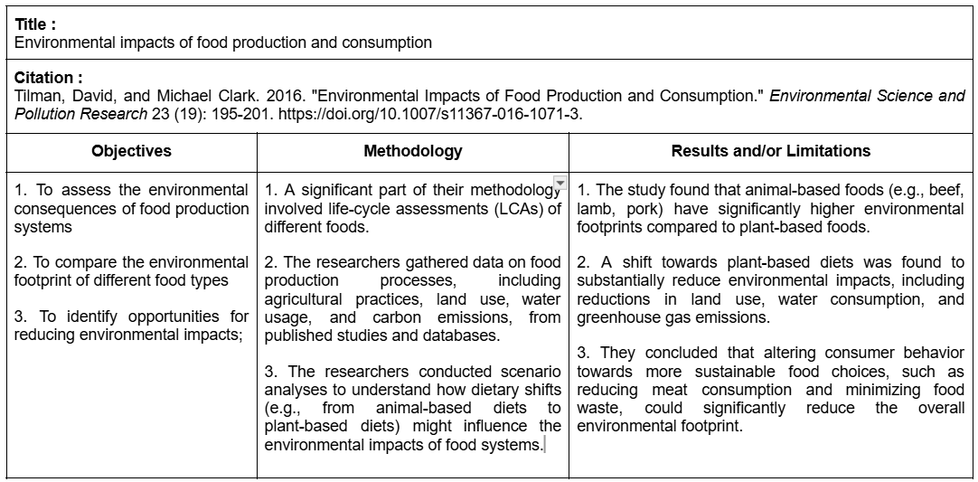
Literature Survey
Notes:
Aditi

Slide 26
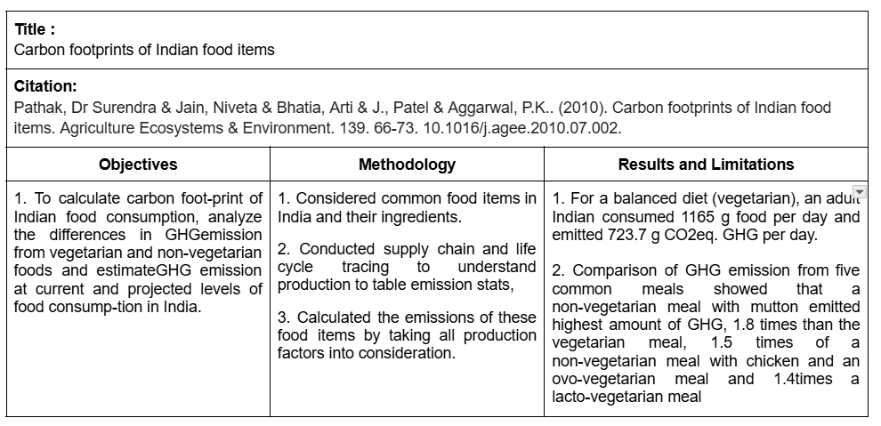
Literature Survey
Notes:
Aditi

Slide 27
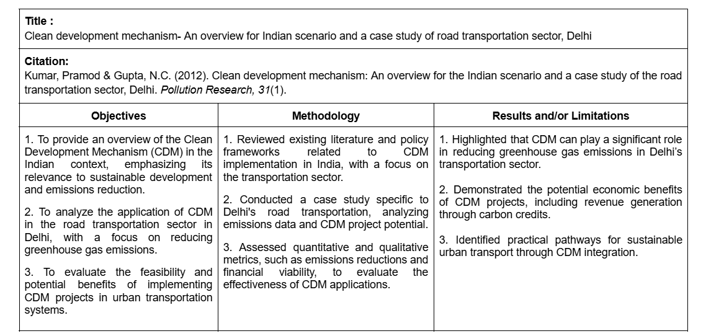
Literature Survey
Notes:
Aditi

Slide 28
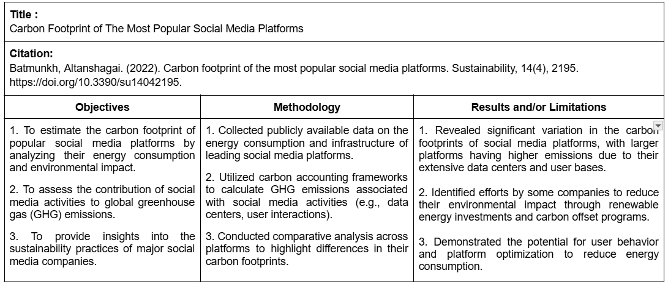
Literature Survey
Notes:
Aditi

Slide 29
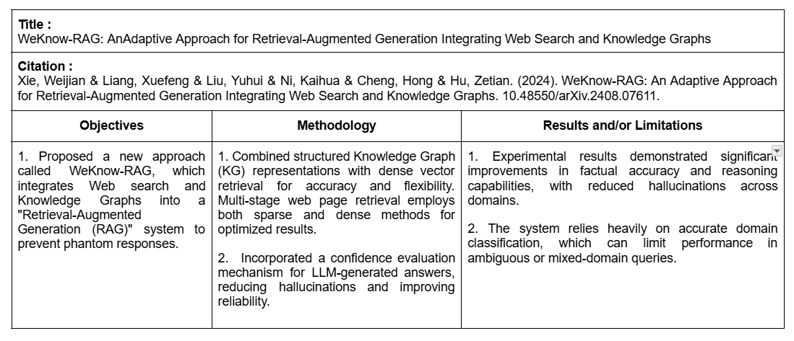
Literature Survey
Notes:
Arya

Slide 30
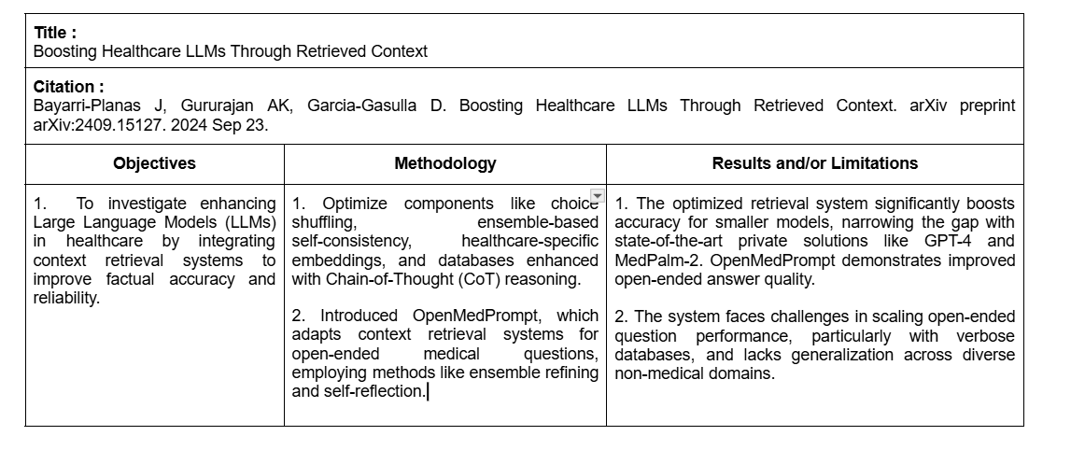
Literature Survey
Notes:
Arya

Slide 31
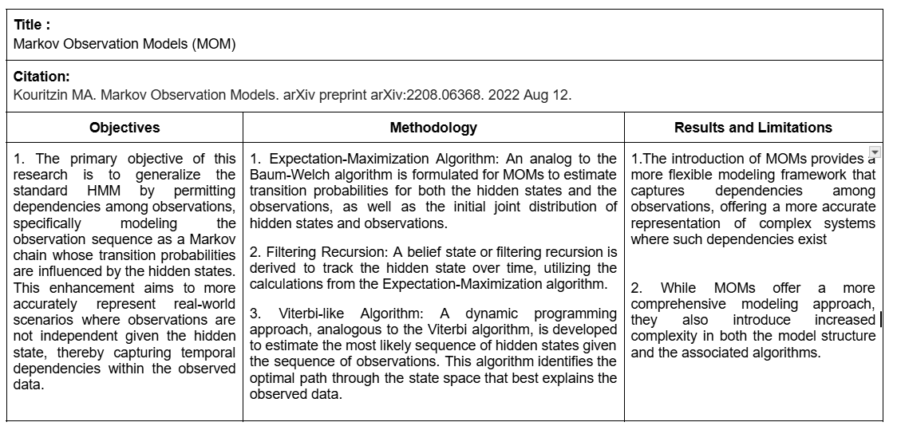
Literature Survey
Notes:
Shreyashwini

Slide 32
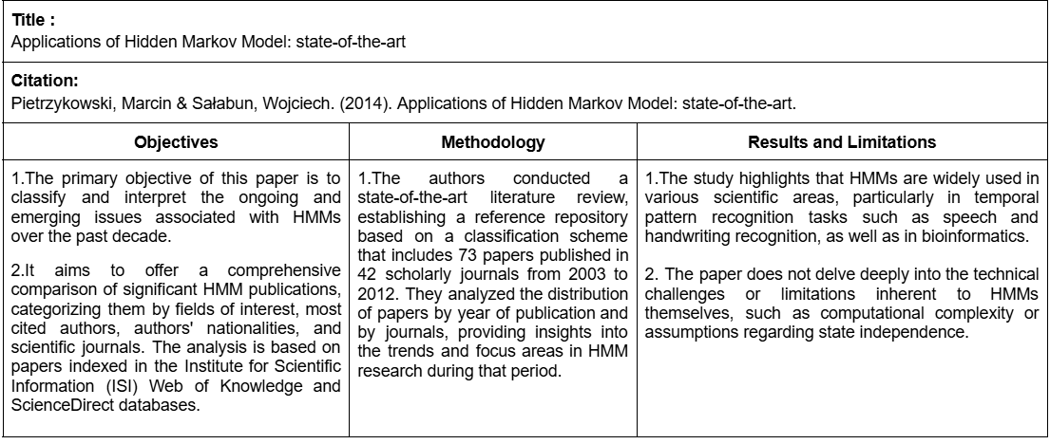
Literature Survey
Notes:
Shreyashwini

Slide 33
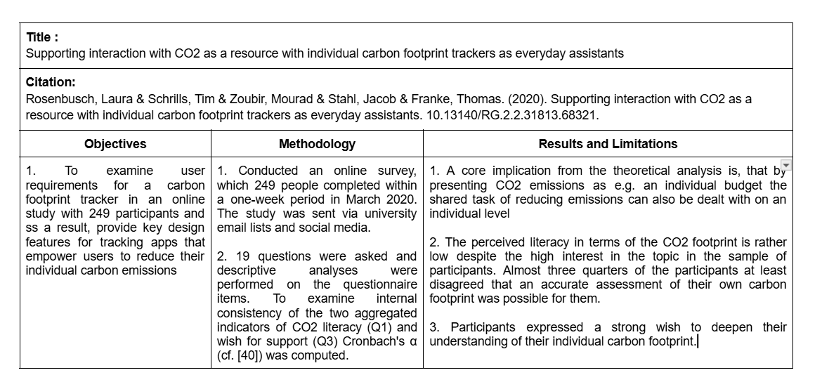
Literature Survey
Notes:
Arya

Slide 34
Problem Statement
An official statement describing the gist of our project and its goals.
Notes:
Aditi

Slide 35

Problem Statement
“To develop an AI-powered mobile assistant to help users track their carbon footprint,
reduce emissions, and support verified carbon offset projects through personalized
recommendations and actionable insights.”
Notes:
Aditi

Slide 36
Objectives
What we hope to accomplish by the end of this project.

Slide 37
Objectives
Every cellular automaton has a collection of cells arranged in a grid that change state from time to time.
Each grid changes states based on a pre-defined set of rules. The outcome is dependent on the states of its neighbours and the automaton after each change is called a generation.
They exhibit deterministic and irreversible behaviour, and evolve in discrete space and time.
They are governed by a global rule that determines how each cell's state evolves based on the state of its neighboring cells.

Slide 38
Objectives
Enable personalized carbon footprint tracking by developing a system to quantify and monitor individual carbon emissions.
Each grid changes states based on a pre-defined set of rules. The outcome is dependent on the states of its neighbours and the automaton after each change is called a generation.
They exhibit deterministic and irreversible behaviour, and evolve in discrete space and time.
They are governed by a global rule that determines how each cell's state evolves based on the state of its neighboring cells.
Notes:
Elvis

Slide 39
Objectives
Enable personalized carbon footprint tracking by developing a system to quantify and monitor individual carbon emissions.
Enhance sustainable consumption practices by leveraging AI to guide eco-friendly shopping, waste management, and the adoption of healthier, environmentally conscious alternatives.
They exhibit deterministic and irreversible behaviour, and evolve in discrete space and time.
They are governed by a global rule that determines how each cell's state evolves based on the state of its neighboring cells.
Notes:
Prabu

Slide 40
Objectives
Enable personalized carbon footprint tracking by developing a system to quantify and monitor individual carbon emissions.
Enhance sustainable consumption practices by leveraging AI to guide eco-friendly shopping, waste management, and the adoption of healthier, environmentally conscious alternatives.
Promote carbon offset initiatives by facilitating user engagement in verified carbon offset projects through financing options and recommendations.
They are governed by a global rule that determines how each cell's state evolves based on the state of its neighboring cells.
They are governed by a global rule that determines how each cell's state evolves based on the state of its neighboring cells.
They are governed by a global rule that determines how each cell's state evolves based on the state of its neighboring cells.
Notes:
Shreyashwini

Slide 41
Objectives
Enable personalized carbon footprint tracking by developing a system to quantify and monitor individual carbon emissions.
Enhance sustainable consumption practices by leveraging AI to guide eco-friendly shopping, waste management, and the adoption of healthier, environmentally conscious alternatives.
Promote carbon offset initiatives by facilitating user engagement in verified carbon offset projects through financing options and recommendations.
Create a means for users to quantify their emissions, and in turn, understand the impact their action have on the larger environment.
Notes:
Aditi

Slide 42
Methodology and Features
The features of this project and the means to accomplish.

Slide 43


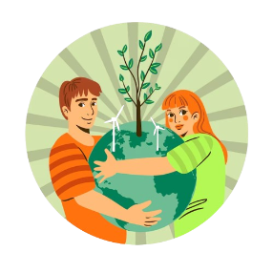
Methodology and Features
Carbon Footprint Tracking
AI-powered Offset Recommender and Financing
Eco-shopping and Waste Assistant

Slide 44
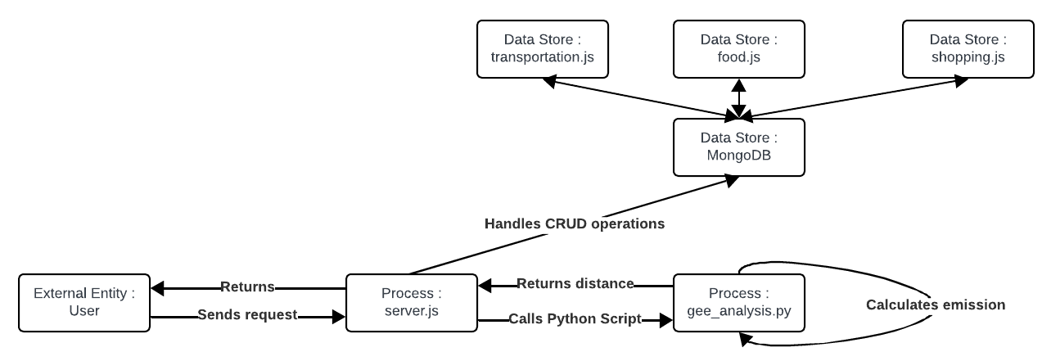
Carbon Footprint Tracking
AI-powered Offset Recommender and Financing
Eco-shopping and Waste Assistant
Notes:
Aditi

Slide 45
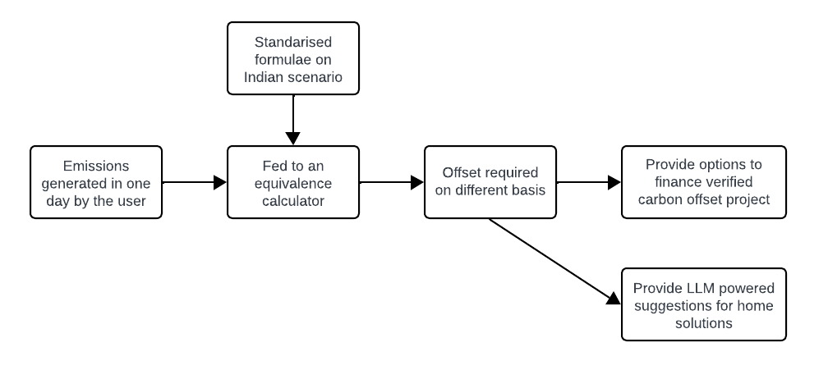
AI-powered Offset Recommender and Financing
Carbon Footprint Tracking
Eco-shopping and Waste Assistant
Notes:
Shreyashwini

Slide 46
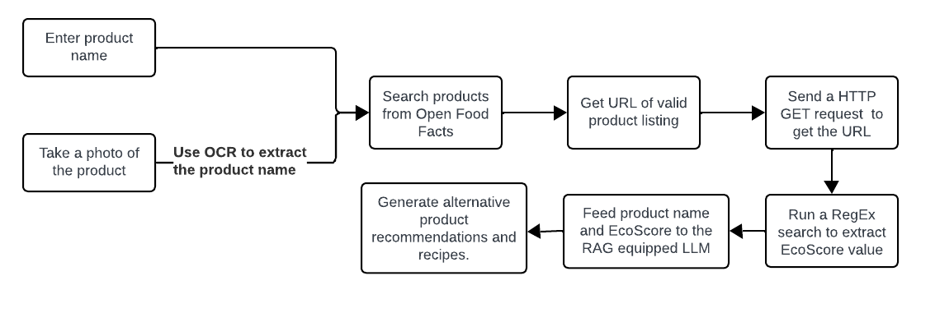
Eco-shopping and Waste Assistant
AI-powered Offset Recommender and Financing
Carbon Footprint Tracking
Notes:
Prabu, Elvis, Arya

Slide 47
Auxiliary Features
Users can set budgets for each month and check how much they have contributed to it and/or how much they have exceeded the budget by.
Community challenges like “Eat vegan for a week” or “Plant 3 trees in one month”.
Provide likelihood estimations using Markov models, trained on previous data of users, to allow for realistic target setting and achievements.
Notes:
Prabu

Slide 48
Novelty
Features that distinguish the project from previously implemented solutions along the same lines.

Slide 49
Novelty
More extensive means for tracking carbon footprint, with integration of better technologies like map tools and a more diverse array of trackers.
Integration of web-search based RAG systems, supported with image capture for both shopping as well as recycling.
Community-based initiatives with smart ML based predictors to allow for more personalization.
Notes:
Shreyashwini

Slide 50
Work Completed
The work that has been implemented so far.

Slide 51

Work Completed
RAG with LLM and web search using Llama 3.23B Instruct model (running locally using Ollama) and SearXNG, both for the shopping and recycling assistants.
OCR tool for detecting the names of labels from user-captured grocery items.
Carbon footprint calculations, storage and retrieval for transportation, food and shopping.
Notes:
Elvis

Slide 52
Work To Be Done
The work that will be completed as a part of Phase II and III.

Slide 53
Work To Be Done
Frontend development. Current options under consideration are React Native and Thunkable.
Auxiliary components of the app like community challenges and budget setting, and dependent components like the hidden Markov model.
Climate offsetting and financing feature, along with the identification of climate offset projects with minimal contribution requirements.
Notes:
Arya

Slide 54
Work Completed in Phase II
The work that has been implemented so far.

Slide 55
Work Completed
Frontend Implementation using FlutterFlow.
Integration of frontend and backend with database.
Notes:
Elvis

Slide 56
Pain Points

Slide 57
Pain Points
Trouble integrating the API with the app.
Notes:
Arya

Slide 58
Thank You

